Slide 1
Re-imagining Kennecott: Collaboration for Successful Residential and Ecological Reuse
John Birkinshaw
Principal Advisor, Land Management
Kennecott Utah Copper, LLC

Slide 2
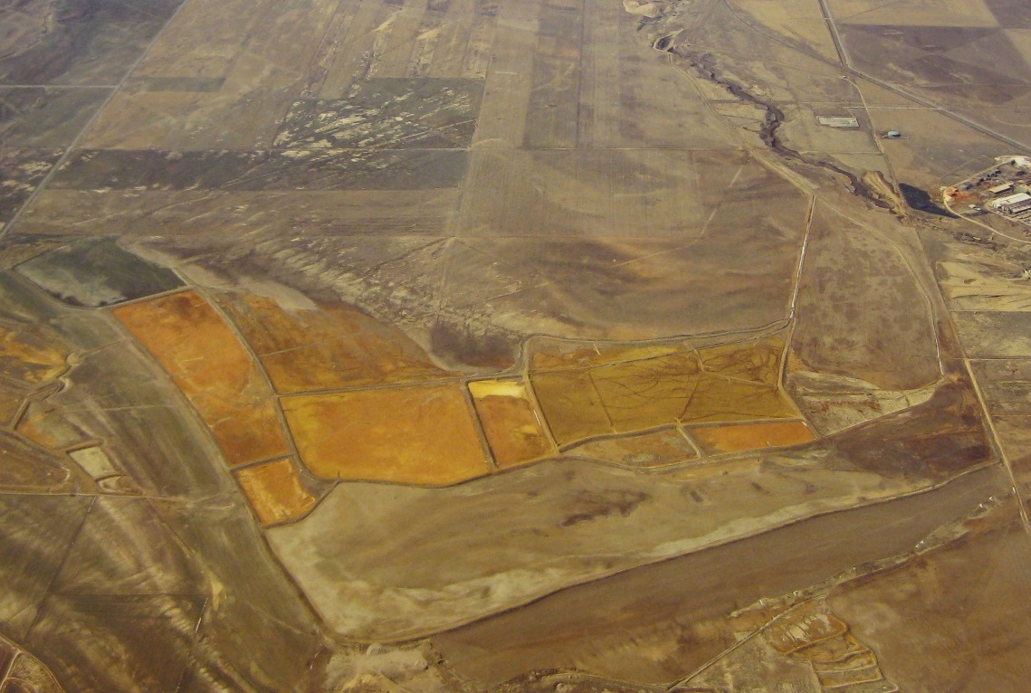
Adapting Industrial Lands for Future Use
South Jordan Evaporation Ponds (Source: Rio Tinto Kennecott)
Notes:
This presentation will share insights learned from working with EPA and the Utah Department of Environmental Quality to adapt a former industrial site and surrounding lands into a mixed-use residential and commercial area, an ecological preserve and an educational asset to the community.
I will discuss how to consider site uses early in the cleanup process and consider community input, giving an overview of the redevelopment of the site, from planning to construction.

Slide 3
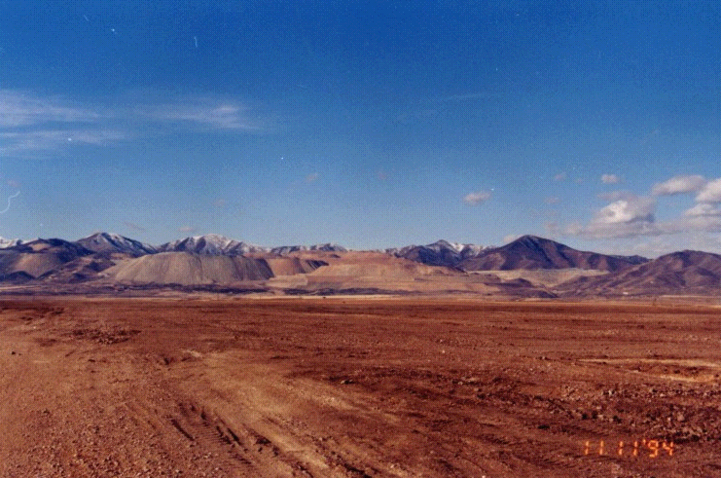
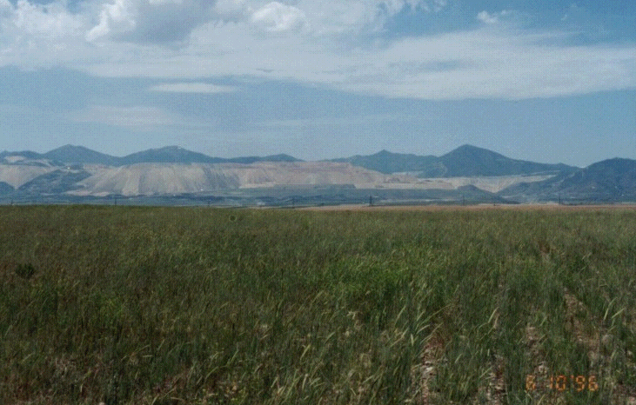
South Jordan Evaporation Ponds
South Jordan Evaporation Ponds during Reclamation
South Jordan Evaporation Ponds after Reclamation
Notes:
South Jordan Evaporation Ponds, before and after reclamation

Slide 4
South Zone - Daybreak Community Timeline
1999 – Master Plan for Daybreak Community
2001 – Kennecott Land Company established
2003 - Construction begins at Daybreak
November 2004 – Daybreak Move-In
August 2005 - Daybreak Elementary Opening
Notes:
In 1999, following the cleanup of the South Jordan Evaporation Ponds, plans to develop the area began. Kennecott worked with EPA, UDEQ and other stakeholders to develop the master plan for Daybreak community.
In 2001, Kennecott Land Company was established to focus on developing Kennecott Utah Copper Corporation’s land.

Slide 5
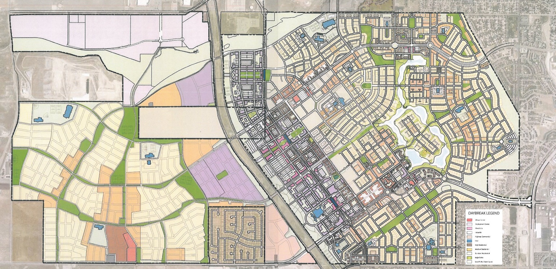
Daybreak Community Master Plan
Notes:
Here is the general plan for the property designed by an internationally recognized land planner. This plan shows the mixed-use areas of the community and the plans for residences, a community center and school.
South Zone OU 7 was suited to redeveloped because of its proximity to areas with existing commercial and residential development along three sides (indicate the existing development along the north, south and eastern edges.)
As Douglas mentioned, the planned reuse of the site guided the cleanup.

Slide 6
South Zone - Daybreak Community Timeline Cont.
1999 – Master Plan for Daybreak Community
2001 – Kennecott Land Company established
2003 - Construction begins at Daybreak
November 2004 – Daybreak Move-In
August 2005 - Daybreak Elementary Opening
Notes:
Kennecott and the City of South Jordan, with oversight from EPA and UDEQ, collaborated on the planning and development of Daybreak from the cleanup to final construction and maintenance.
In 2003, as cleanup of areas of the site was completed, residential, commercial, and public services construction began at Daybreak. By November 2004, the first residents moved into Daybreak homes. Approximately 13 percent of the Daybreak community was developed on South Zone OU7.
Much of the remaining reclaimed area is now a 67-acre freshwater lake called Oquirrh Lake. The lake is a recreational amenity for the Daybreak community, providing opportunities for boating and fishing, in addition to a surrounding walking trail, parks and beaches.
Later in August 2005, Daybreak Elementary, a school and neighborhood learning and community center, opened on the site.

Slide 7




Daybreak
Notes:
The map above shows an aerial view of OU7 and surrounding areas, the community now has access to new residential, commercial and recreational amenities.
EPA, UDEQ, Kennecott, the City of South Jordan and other stakeholders worked closely to ensure that community perspectives and priorities were represented in the planning and result of the project. Kennecott, with EPA and UDEQ input, held discussions and meetings with the community, which were needed to build a strong foundation for the Daybreak project. Kennecott brought community stakeholders and site agencies together to discuss development components, potential challenges and opportunities, and next steps.

Slide 8
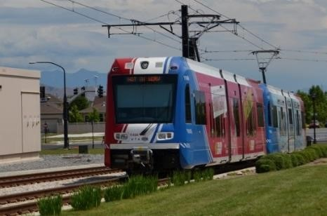
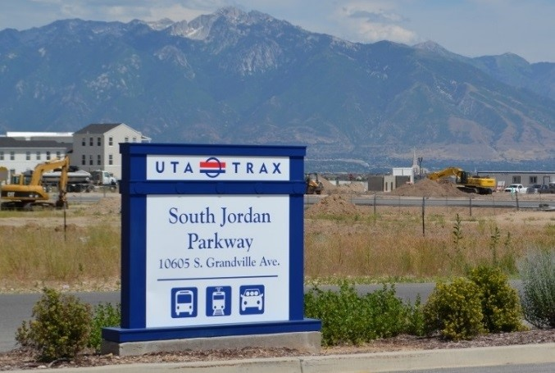
Daybreak Community - Transit
Utah Transit Authority light rail service in Daybreak.
Notes:
Kennecott donated land to allow for the construction of the Utah Transit Authority’s TRAX red line, connecting Daybreak to downtown Salt Lake City. Since the 2010 opening of the TRAX Mid-Jordan rail line, there are two light rail stations in Daybreak.
All the lines of the UTA TRAX had 1,630,544 riders in the month of August 2016, up 3.06% from August 2015 when there were 1,582,142 riders.

Slide 9
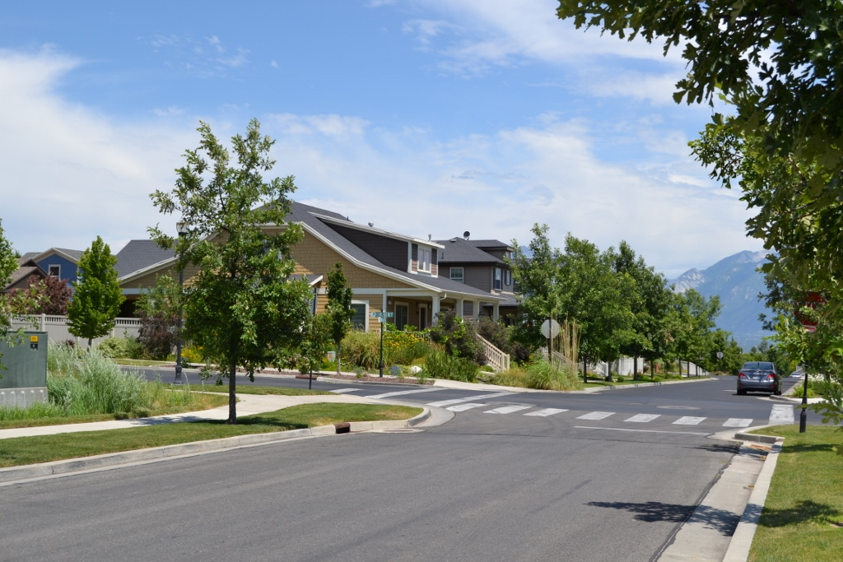
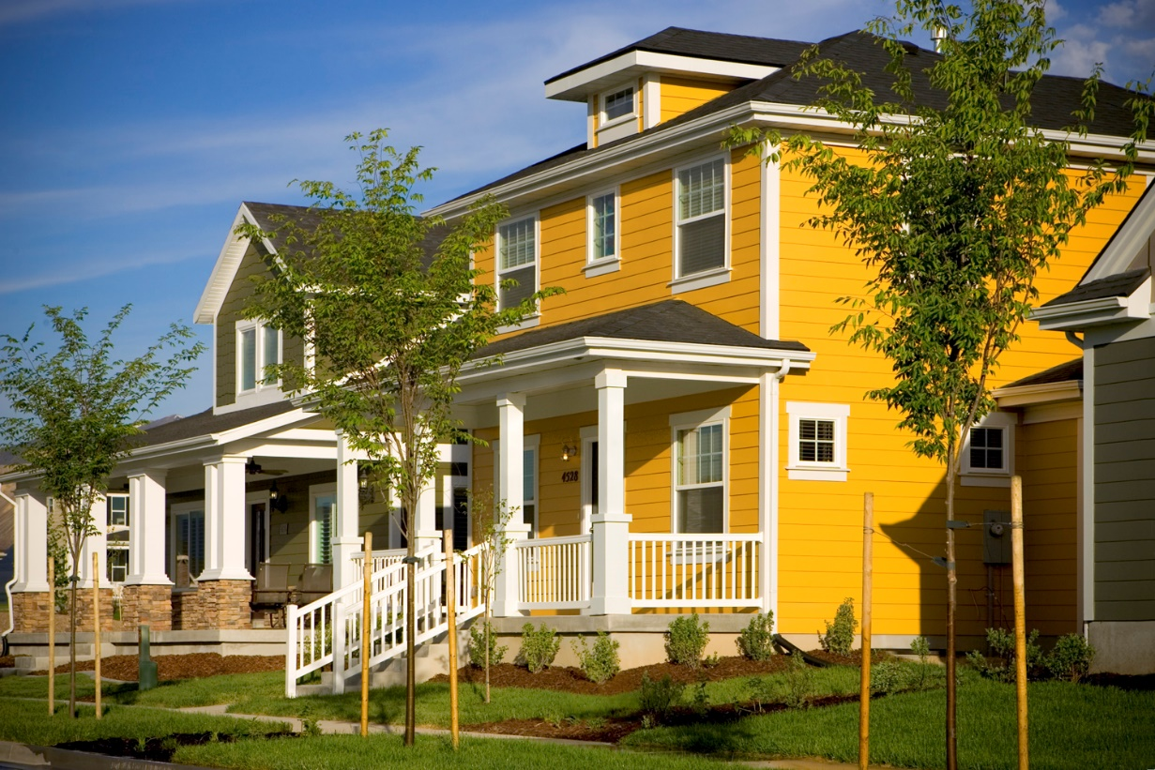
Daybreak Community - Housing
Notes:
All 4,000+ homes in the Daybreak development are Energy Star-certified and provide much needed sustainable housing for the greater Salt Lake City area. Energy Star certification is a federally-backed labeling program that identifies factories, office equipment, home appliances and electronics that have superior energy efficiency.

Slide 10
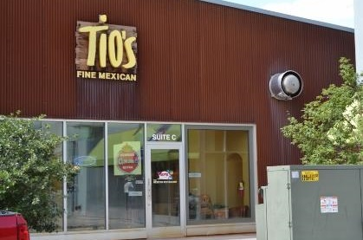
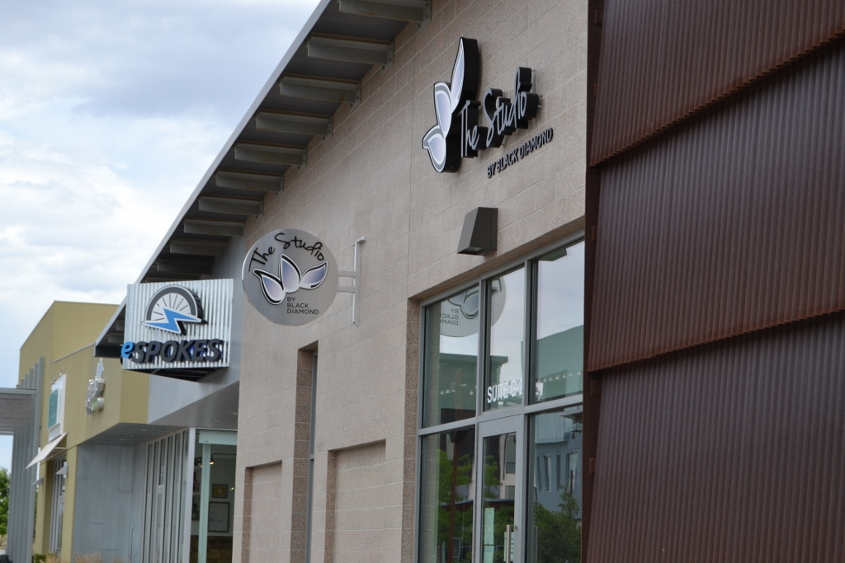
Daybreak Community – Commercial
Notes:
Businesses in and around Daybreak employ nearly 850 people and provide nearly $35.2 million in employment income annually. Local Daybreak businesses generate about $141.4 million in annual sales.*
Businesses include the Black Diamond Gymnastics & Sports Center, Tio’s Mexican Restaurant, eSpokes bike shop, Dave’s Barber Shope, several medical practices, Nest Boutique clothing store and more.
*These numbers are from the unpublished draft Kennecott (South Zone) Superfund Site Economic Case Study in development by Skeo.

Slide 11
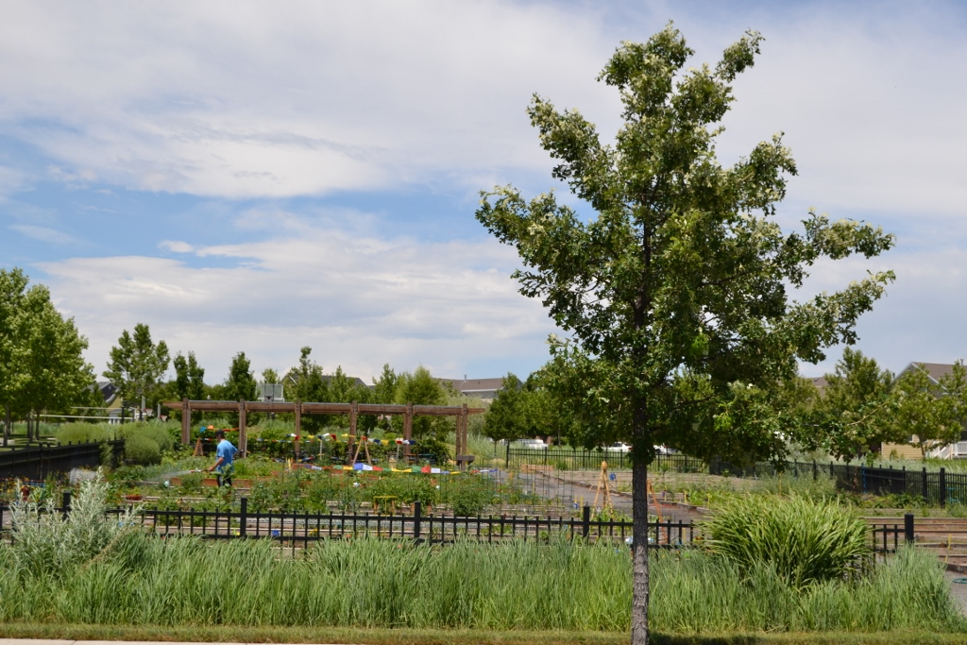
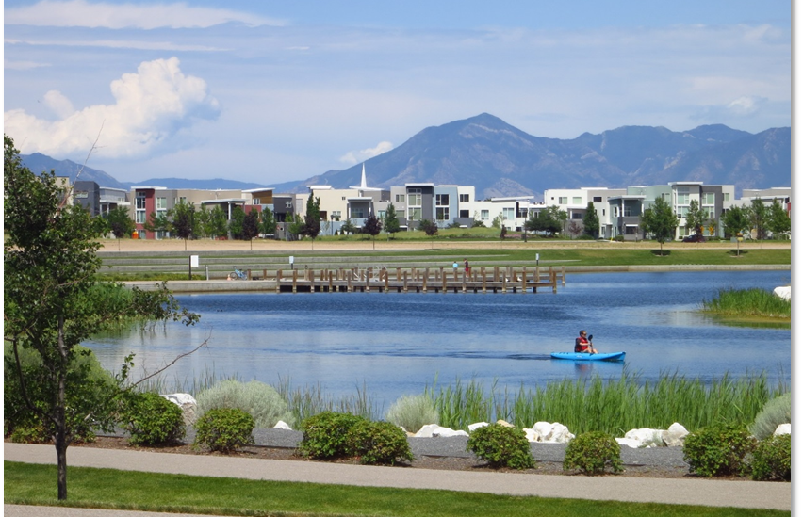
Daybreak Community – Ecological
Notes:
On the left , a photo of a community garden in the Daybreak community. Right, a photograph of Daybreak’s Oquirrh Lake. Cleanup has restored 1,000 acres of wildlife habitat and open space, planted 135,000 trees and several thousand acres of shrubs, plants and grasses. After restoration around Oquirrh Lake, fifty-nine species of birds live nearby.

Slide 12
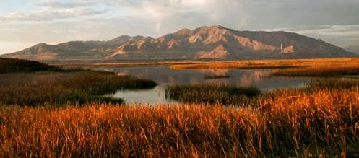
North Zone Reuse – Water Fowl Reserve
View from Inland Sea Shorebird Reserve toward Smelter.
Notes:
A portion of the site bordering the Great Salt Lake was a degraded wetland. Kennecott purchased the land and revitalized it, turning it into a shorebird and waterfowl reserve. Now the area serves as a safe haven for birds along the south shores of the Great Salt Lake.
The revitalized wetlands is also an important educational and scientific resource where birding groups, schools and university research teams observe and study.
In addition to the reserve, a portion of the site continues to be residential.

Slide 13
For More Information, Contact
John Birkinshaw
Principal Advisor, Land Management
Kennecott Utah Copper, LLC
Phone: 801-204-2756
Email: john.birkinshaw@riotinto.com

